Slide 1
Android Team: Abhay Gupta Gaurav Halbe Mayank Chacko Rohit Kandhal
Walk North Hills

Slide 2
Presentation Outline
Quick Recap
New Approach
Prototype
Things Remaining
Q&A

Slide 3
About the ‘Walk Campaign’
Initiated by Matt Tomasulo
Encourage people to walk
Integrates key features of initial physical campaign

Slide 4
New Approach
Keep the app simple ( No weather, refresh etc. )
Dynamic Database
Google Maps API integration
Showing walkable route between two places
Category Selection

Slide 5
Things left to do…
Creating of local copy of database
Addition of info view about the destination
Bonus
Admin interface on web for add/remove destinations
Favorites
Cumulative walking minutes

Slide 6
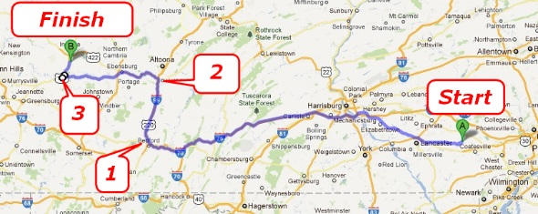
Google Direction Api

Slide 7
Google Distance Matrix api
Source
Destination 1
Destination 2
Destination 3
Destination 4
Destination 5
 | Destination 1 | Destination 2 | Destination 3 | Destination 4 | Destination 5
Source | 3 km/ 15 mins | 6 km/ 30 mins | 9 km/45 mins | 10km/50 mins | 1 km/ 5 mins

Slide 8
Prototype

Slide 9
Questions?

